Slide 1
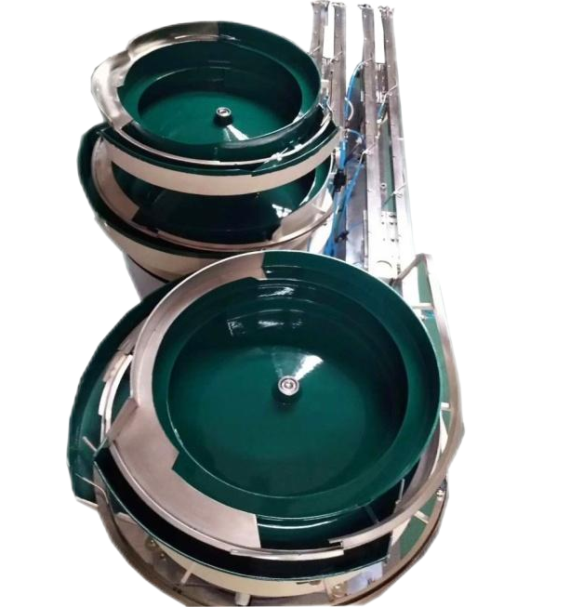
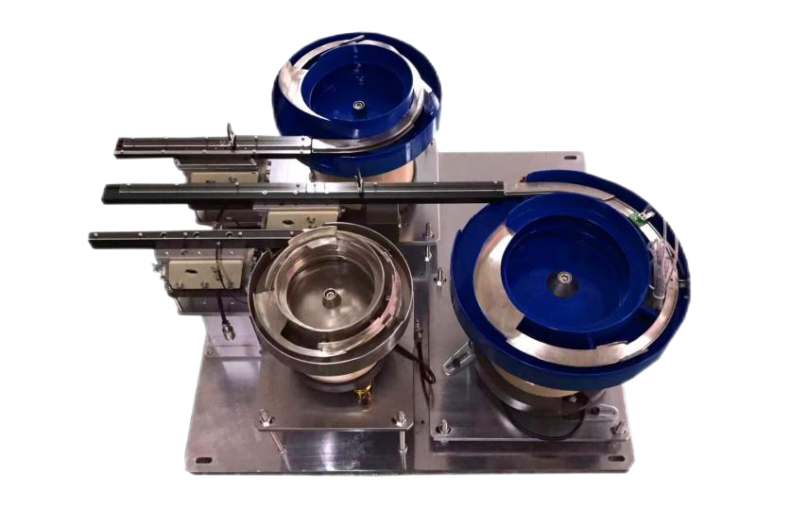
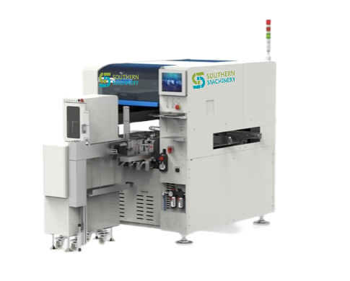
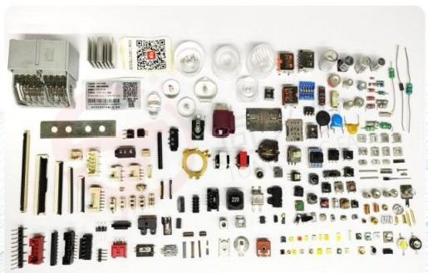
S7900series Insert Machine Introducing Customized Feeder and Nozzles
PRODUCT GUIDE
www.SMThelp.com
Mail me: Frank@smthelp.com

Slide 2
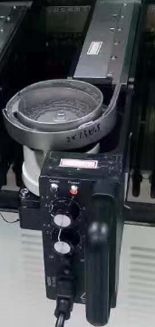
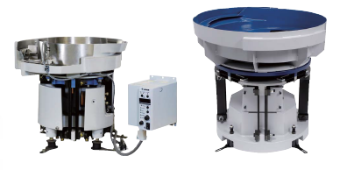
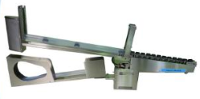
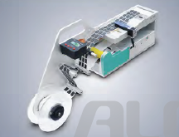
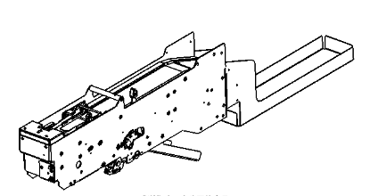
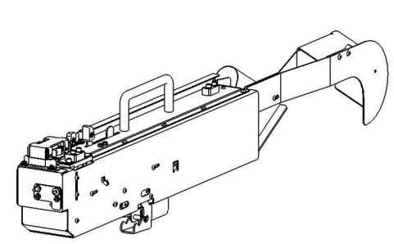
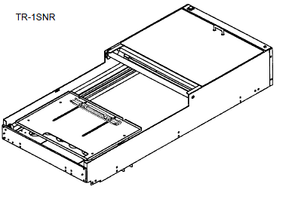
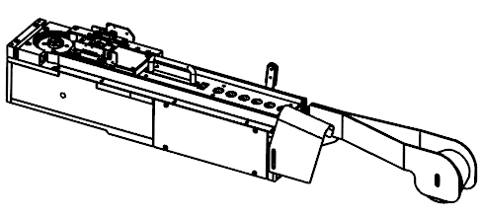
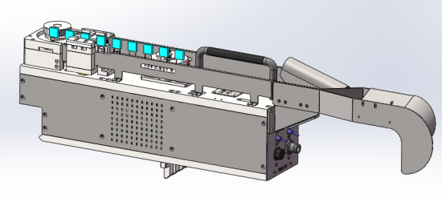
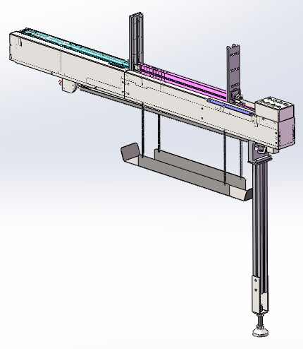
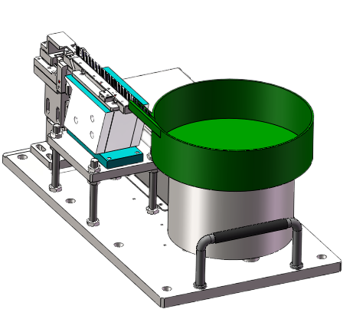
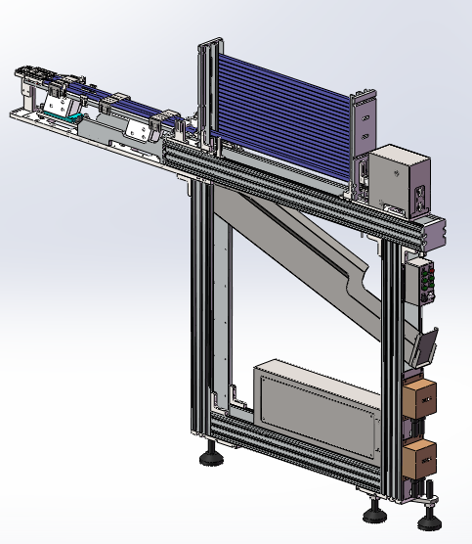
Introducing Of Customized Feeder
Precision vibration plate: suitable for patch, plug-in machine, non-standard assembly
Multi-tube feeder: suitable for patch, plug-in machine, non-standard assembly
Precision vibration plate: suitable for bulk material patch
Labeling feeder: suitable for patch, plug-in machine, non-standard machine labeling module
Horizontal resistor feeder: suitable for SMD, plug-in machine, non-standard machine feeding module
Vertical Tape Feeder: Suitable for SMT, Plug-in Machine, Non-standard Machine Feeding Module
Tray feeder: suitable for SMT, plug-in machine, non-standard machine feeding
Vertical Tape Feeder: Suitable for SMT, Insertion Machine, Non-standard Machine Feeding
Vertical Tape Feeder: Suitable for SMT, Insertion Machine, Non-standard Machine Feeding
Multi-tube vibration-free feeder: suitable for patch, plug-in machine, non-standard assembly
Vibrating plate feeder with powder material: suitable for patch, plug-in machine, non-standard assembly
Multi-tube external feeder: suitable for patch, plug-in machine, non-standard assembly
Mail me: Frank@smthelp.com

Slide 3
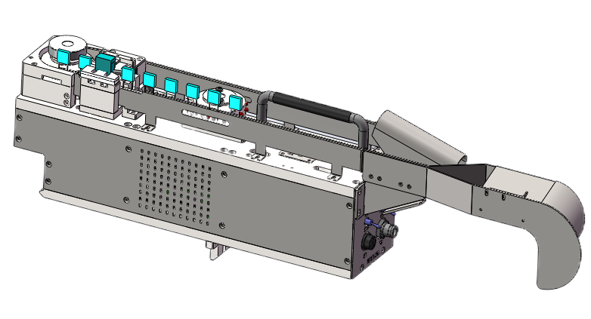
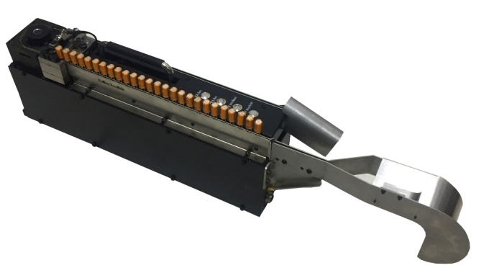
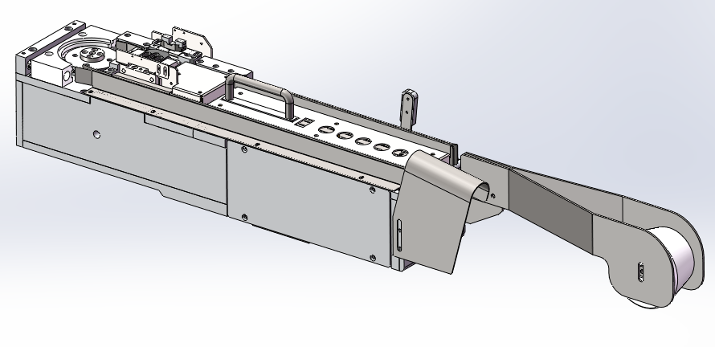
Radial Taping Feeder
name | Radial Taping Feeder
Body diameter | Element capacitor: ø3-ø10mm ; Square capacitor: width 5-10mm , length 5-25mm
Height | 5mm-25mm
Tape hole distance | 12.7mm or 25.4mm​
Pin wire diameter | 0.4mm-1.0mm
Pin spacing | 2.5mm-25mm
Cutting length | 2.5mm- 5mm
Feeding method | Motor drive
Discharging time | 1.5s-2s
Suitable components | Capacitors, inductors, terminals, springs, iron sheets
Incoming material packaging method | Taping method
Dimensions | 500 (L) x 100 (W) x 165 (H)
( 1 ): The flying height and communication signal can be changed according to the client station;
( 2 ): Applicable to JUKI , YAMAHA , FUJI , Panasonic , Siemens , SAMSUNG SMT machines
Applying the placement machine to the plug-in field can save labor and improve production capacity.
Mail me: Frank@smthelp.com

Slide 4
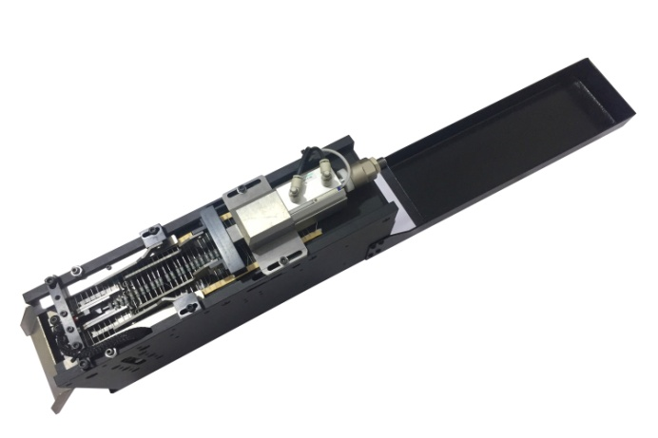
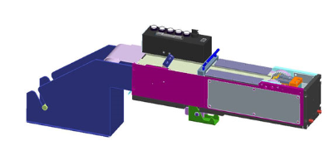
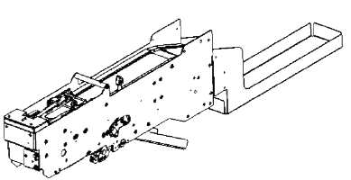
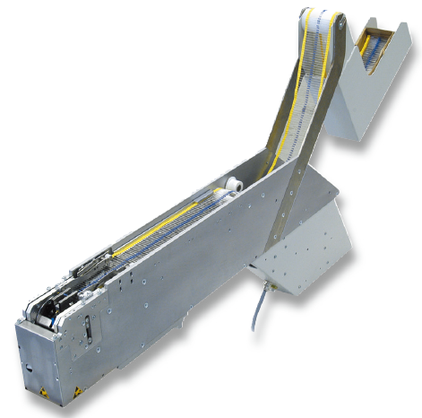
Axial Taping Feeder
name | Axial Taping Feeder
Body diameter | ø2-ø10mm
Component spacing | 5mm, 10mm, 15mm, 20mm
Pin wire diameter | 0.4mm-1.0mm
Cutting length | 2.5mm-5mm
Feeding method | Pneumatic feeding
Discharging time | 1.5s-2s
Suitable components | Resistors, diodes, jumpers
Incoming material packaging method | Taping method
Dimensions | 700 (L) x 100 (W) x 165 (H)
Mail me: Frank@smthelp.com

Slide 5
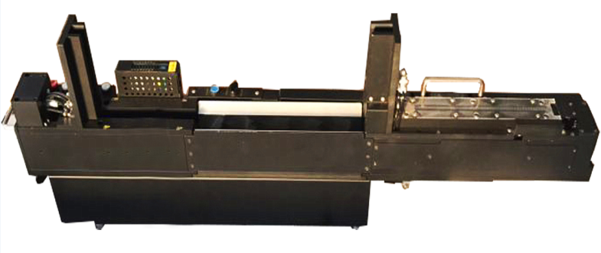
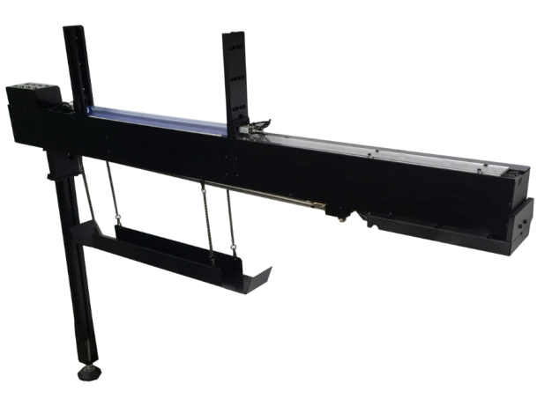
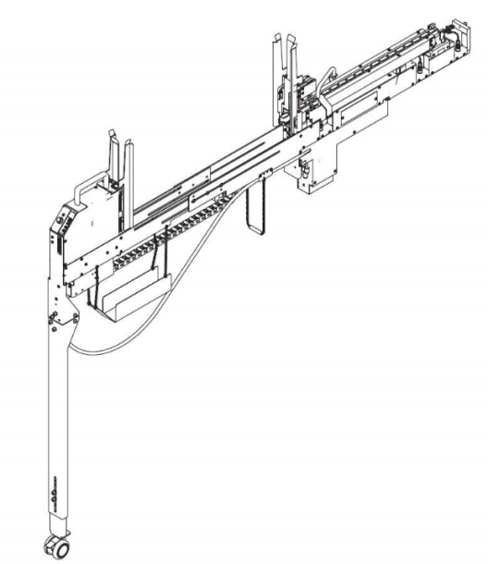
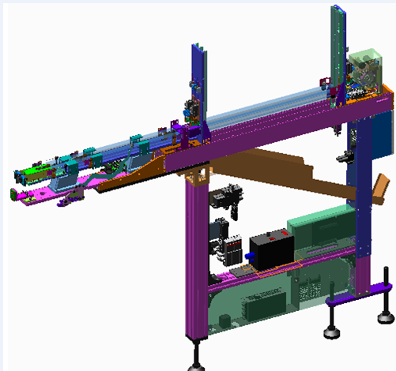
Tube Feeder
name | Tube Feeder
Component size | 5x5mm-25x25mm
Pipe length | 300mm-650mm
Feeding method | Motor feeding
Discharging time | 1.5s-2s
Suitable components | Transformer, relay, terminal, transistor
Incoming material packaging method | Tube material
Dimensions | 1480 (L) x 100 (W) x 165 (H)
Mail me: Frank@smthelp.com

Slide 6
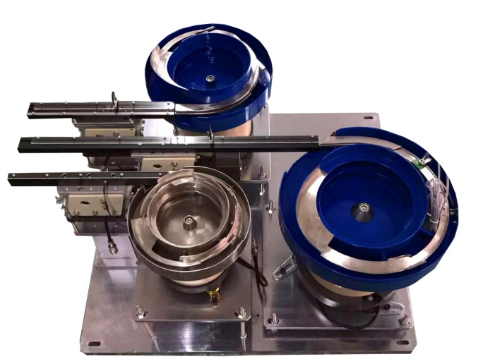
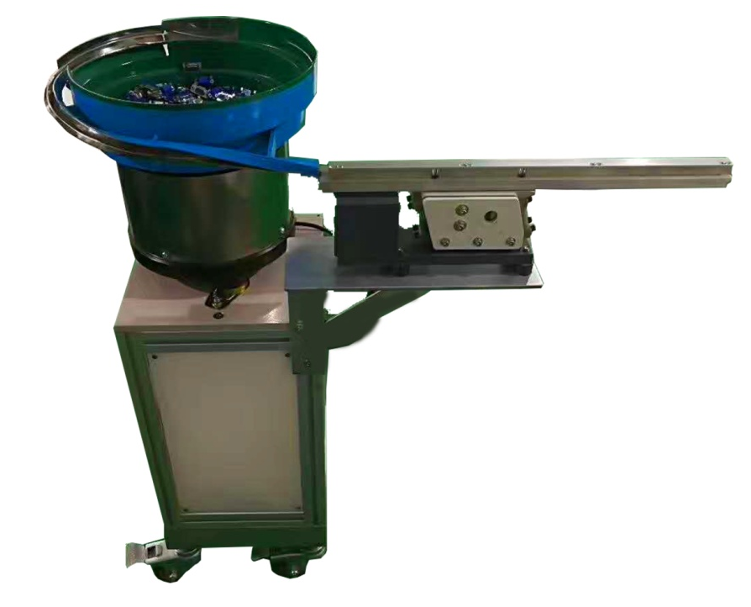
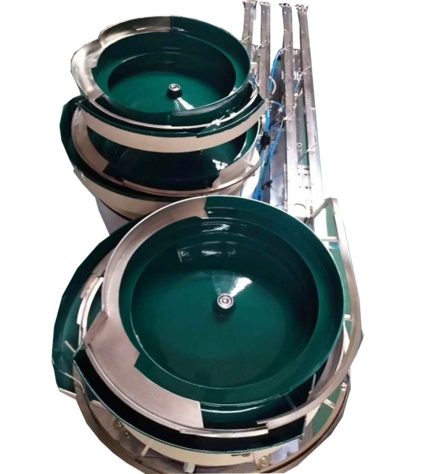
Vibrating plate feeder
name | Vibrating plate feeder
Component size | 5x5mm-25x25mm
Feeding method | Vibration feeding
Discharging time | 2s-3s
Suitable components | Terminals, iron sheets, capacitors
Incoming material packaging method | Bulk material
Dimensions | Customized according to materials
Mail me: Frank@smthelp.com

Slide 7
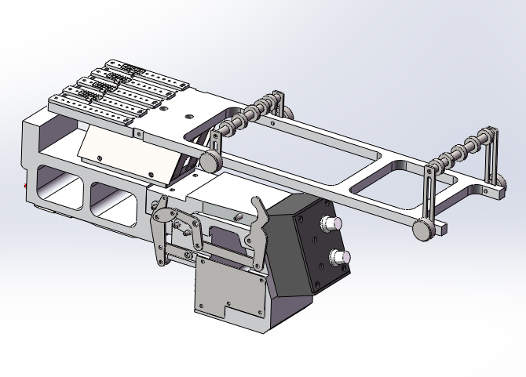
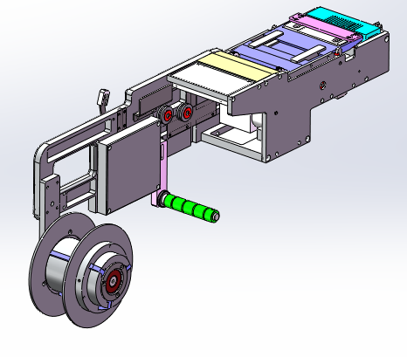
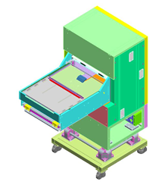
Vibrating tube; feeder Label Feeder; Pallet Feeder
Vibrating tube feeder
Label Feeder
name | Tube Feeder
Component size | 5x5mm-10x10
Feeding method | Vibration feeding
Discharging time | 2s-3s
Suitable components | Terminals, iron sheets, capacitors
Incoming material packaging method | Tube material
Dimensions | 400 (L) x 100 (W) x 165 (H)
Pallet Feeder
name | Label Feeder
Component size | 5x5mm-10x10
Feeding method | Motor rotation
Discharging time | 1S-1.5S
Suitable components | Label, QR code
Incoming material packaging method | Roll
Dimensions | 350 (L) x 100 (W) x 165 (H)
Mail me: Frank@smthelp.com

Slide 8
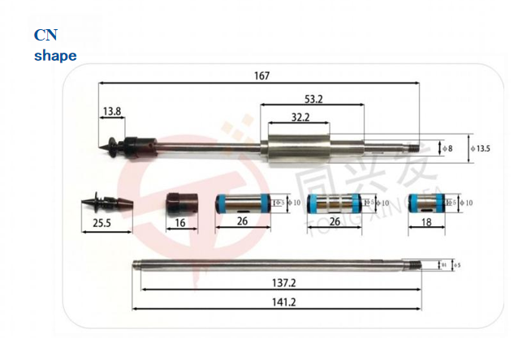
Customized Nozzles
Mail me: Frank@smthelp.com

Slide 9
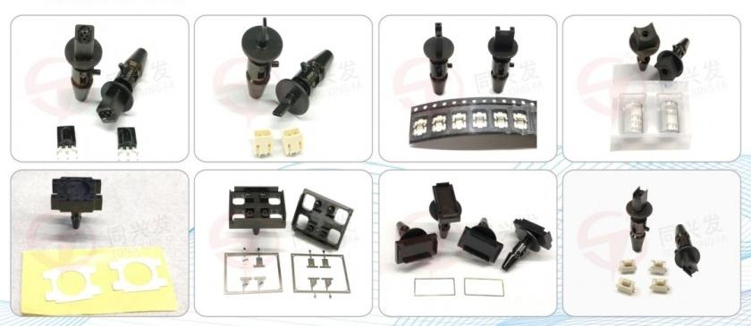
Customized Nozzles
 | Standard nozzle size table
model | Specifications (outer diameter/inner diameter) | Component Type
CN020 | 0.5/0.16 | 0201
CN030 | 0.6/0.28 | 0201,0402
CN040 | 0.7/0.38 | 0402
CN065 | 1.2/0.65 | 0603,3014
CN080 | 1.5/0.8 | 0603,0805
CN110 | 1.8/1.1 | 1206,2125
CN140 | 2.2/1.4 | 3216,3528
CN220 | 3.6/2.2 | Resistors, capacitors, ICs, etc.
CN400 | 6.2/4.0 | Resistors, capacitors, ICs, etc.
CN750 | 9.0/7.5 | Resistors, capacitors, ICs, etc.
CN6.0 | 6.0 Suction cup | IC, lens, capacitor, etc.
CN8.0 | 8.0 Suction cup | IC, lens, capacitor, etc.
CN10.0 | 10.0 Suction cup | IC, lens, capacitor, etc.
CN6.0 inner suction cup | Outer diameter 6.0, inner suction cup 3.7 | IC, lens, capacitor, etc.
CN8.0 inner suction cup CN10.0 inner suction cup | Outer diameter 8.0, inner suction cup 6.0 Outer diameter 9.8, inner suction cup 8.0 | IC, lens, capacitor, etc. IC, lens, capacitor, etc.
CN Customized non-standard nozzle
Mail me: Frank@smthelp.com

Slide 10
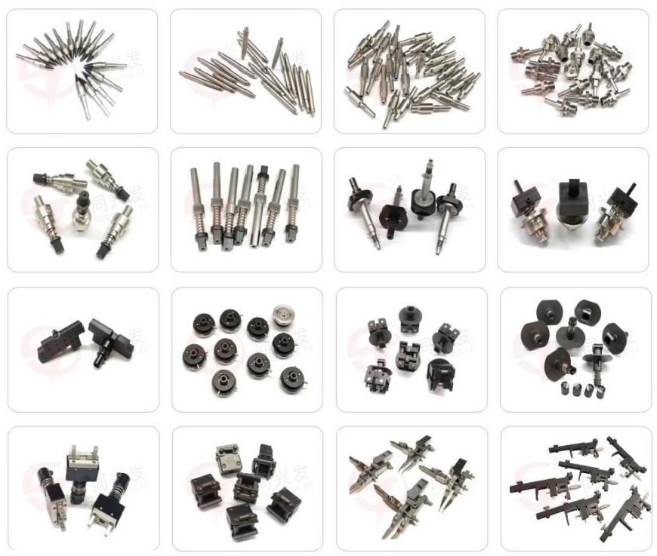
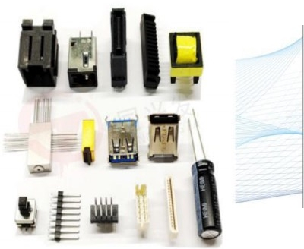
Customized Nozzles
Global Sticky Nozzle
Mail me: Frank@smthelp.com

Slide 11
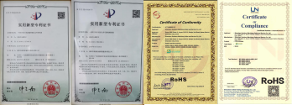
Southern Machinery 2024 Catalog
ABOUT US
With more than 20 years of SMT experience, continuously improve product quality,
product quality is outstanding
Has an independent manufacturing plant and
design team, with independent production and research and development capabilities
We have cooperated with many high-quality customers, and the brand is trustworthy
Mail me: Frank@smthelp.com

Slide 12
Best After-sales service
— 7x24 Worldwide Support
— Free Installation/ Training
— 1 day lead-time (spare parts)
— 1 Month customize solution
Mail me: Frank@smthelp.com

Slide 13
Welcome Inquiry
Please visit
www.smthelp.com
Find us more
https://www.facebook.com/autoinsertion
Know more our team
https://www.linkedin.com/company/smtmachine
Welcome to our factory in Shenzhen China
See more machine working video, please Youtube
https://www.youtube.com/c/Smthelping
Google
Auto+insertion, to get more information
Looking forward to your email
info@smthelp.com
Mail me: Frank@smthelp.com

